Slide 1
Team-Management and Managerial Decision Making
DAY-(2)

Slide 2
TEAM MANAGEMENT PROCESS
Selection
Bonding
Development
Optimizing Performance
Assessment

Slide 3
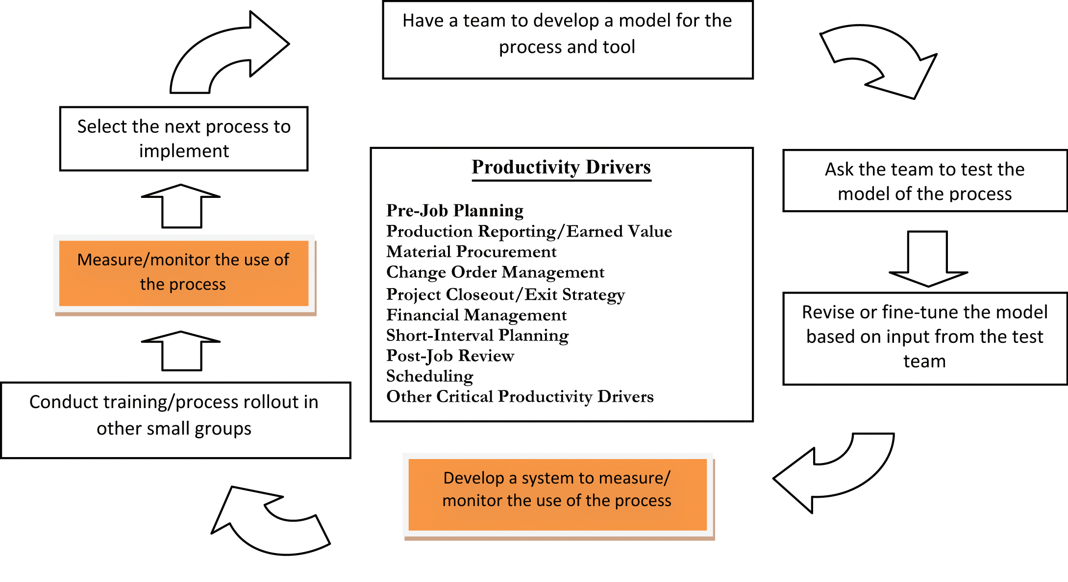
VISUAL REPRESENTATION

Slide 4
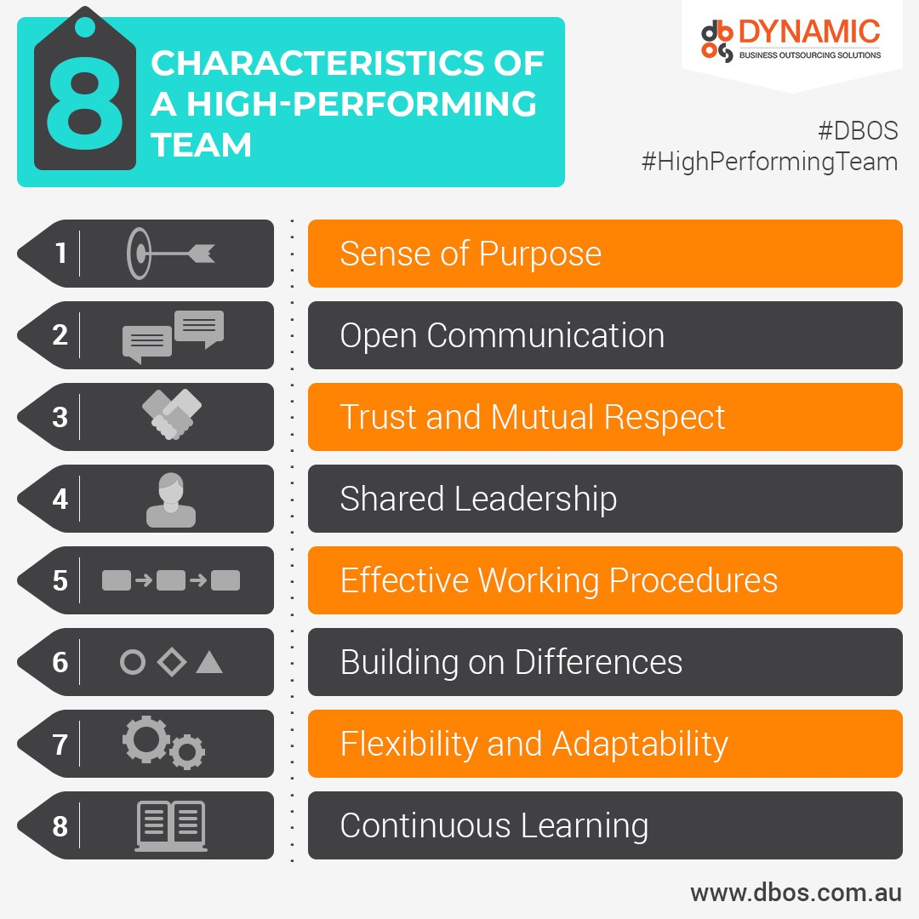
Features of High Performing Team

Slide 5
FACTORS OF LEADERSHIP
Leader
Followers
Communication
Situation

Slide 6
THEORIES
Contingency Theory
Management Theory
Situational Theory
Behavioral Theory
Participative Theory
Relationship Theory

Slide 7
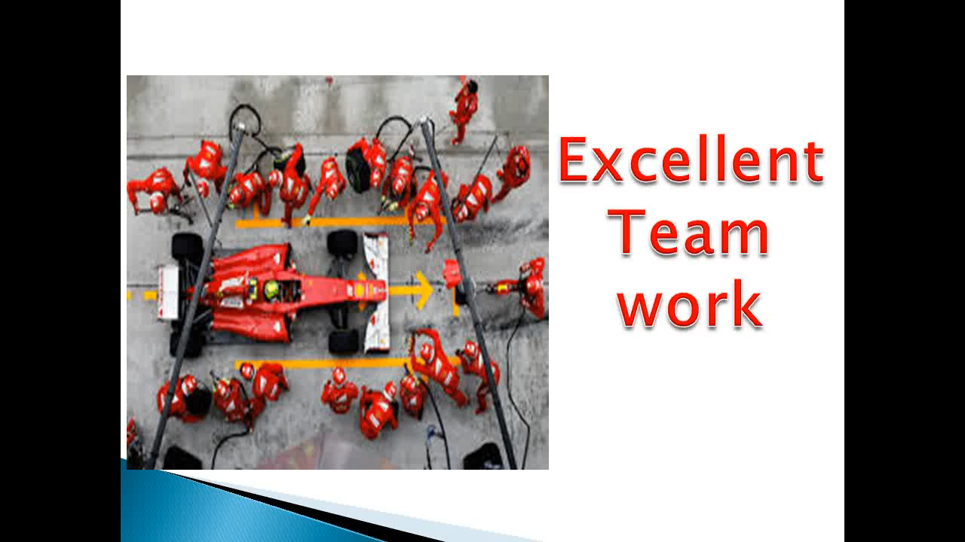
VIDEO

Slide 8
NOTE
CRITICAL LEADERSHIP COMPETENCIES-What makes you a successful leader?
How did you cope up with change?
Economic Development Professional as Leader and Manager.

Slide 9
STYLES OF LEADERSHIP
Autocratic Leadership
Democratic Leadership
Bureaucratic or Rules-centered Leadership
Charismatic Leadership

Slide 10
Leadership Model = Leadership + Authority + Service and Sacrifice + Love + Will

Slide 11
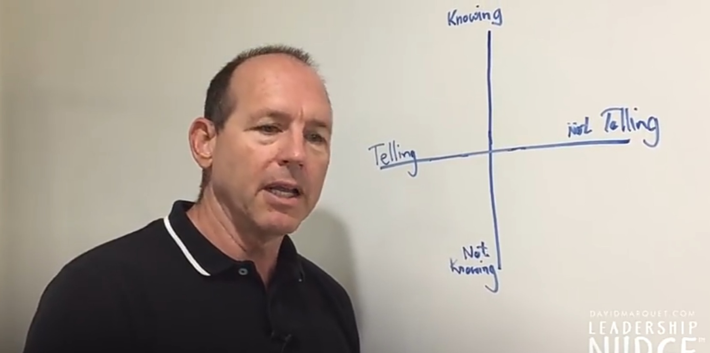
TURN THE SHIP AROUND!

Slide 12
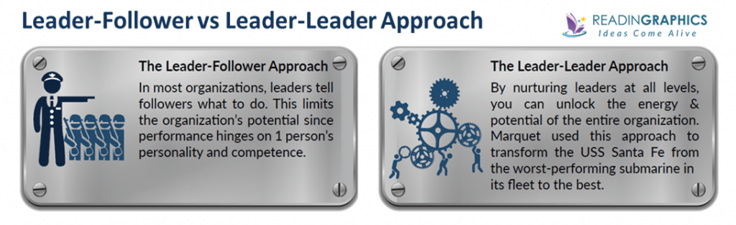

Slide 13
THE FIVE P’s OF LEADERSHIP
Pay Attention
Praise your work
Punish what you want to stop
Pay for the results
Promote people who are efficient

Slide 14
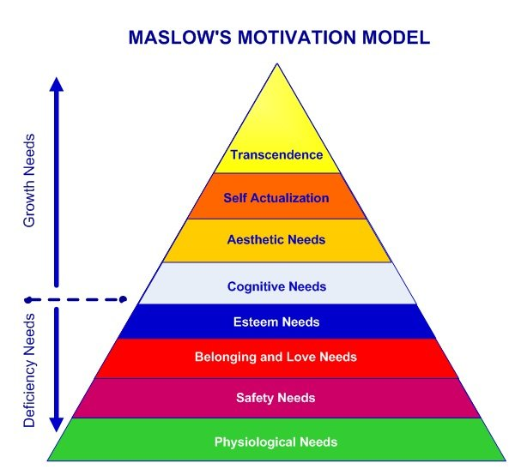
MOTIVATION (1st Theory)

Slide 15
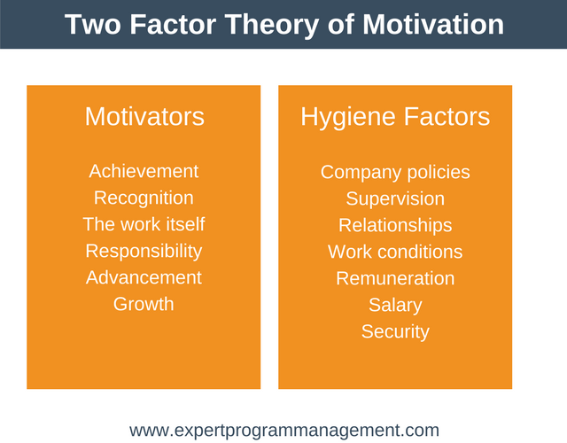
MOTIVATION (2nd Theory)

Slide 16
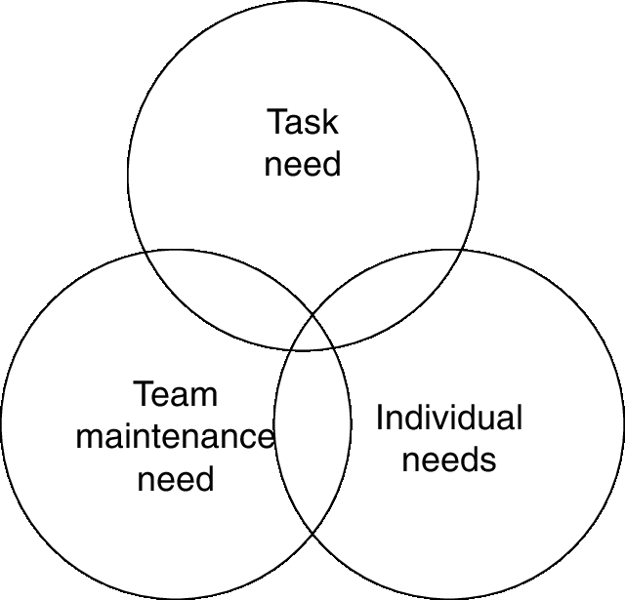
DIAGRAMATIC REPRESENTATION OF LEADERSHIP FRAMEWORK Part-(1)

Slide 17
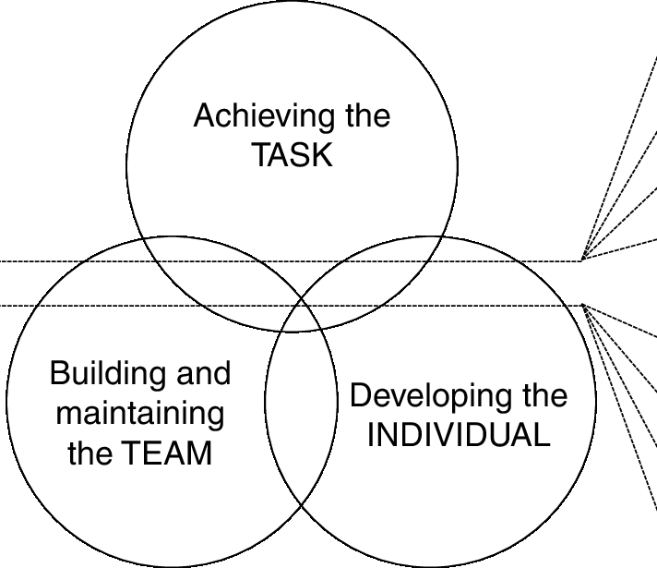
Part-(2)

Slide 18
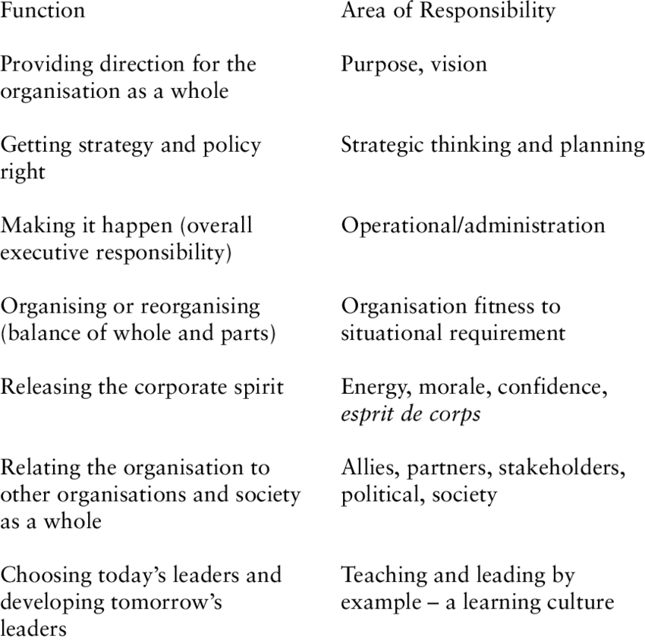
Part-(3)

Slide 19
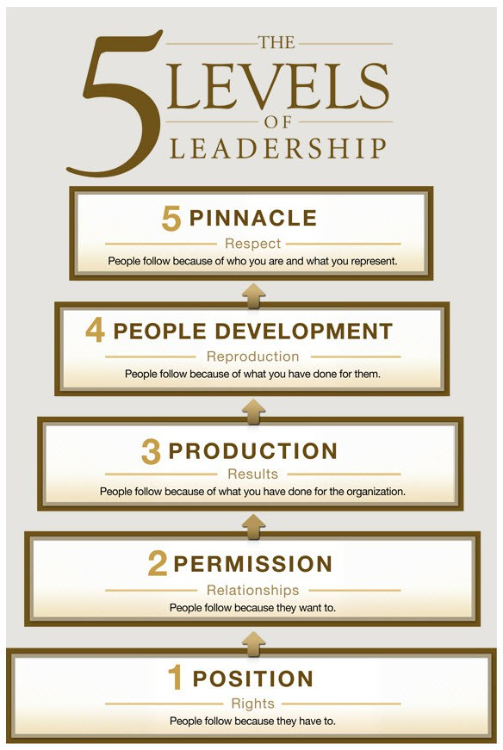
5 LEVELS OF LEADERSHIP

Slide 20


Slide 21


Slide 22
LEADERSHIP TRAITS (ASSIGNMENT)
Choose leaders you admire
What personality traits and skills do they have?
You can also speak about your own experience when you were a leader, but lacked authority.

Slide 23


